Slide 1


Test Automation Using Selenium
Fair Hike Academy
That’s the way the cookie crumbles!
Run → Run As → TestNGTest
Session 16: TestNG with Selenium Webdriver
Mentor : Naresh Vulli, CSTE, PAHM.
fairhike@gmail.com www.fairhike.blogspot.com | www.facebook.com/fairhike

Slide 2
Today’s Topics
Recap
TestNG
Install TestNG
TestNG Library
TestNG program
Run Test
View Results and Report
Takeaways or Exercise

Slide 3
TestNG
‘NG" : "Next Generation“
Driven thru Annotations
Prioritize tests or controlled execution
Parallel test execution
Execution reports
Data parametrization is easy
Xml driven execution
Ability to run thru console
Ability to schedule the test execution

Slide 4
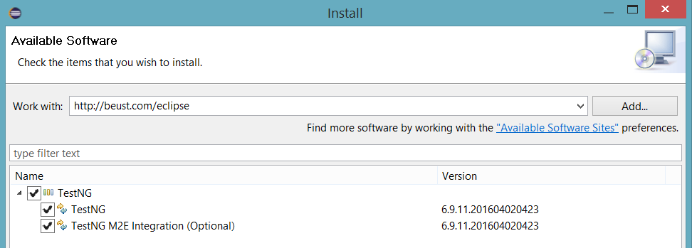
Install TestNG
On the menu bar, click Help.
Choose the "Install New Software..." option.
In Work with text box Type http://beust.com/eclipse
Select all the TestNG updates
Click Next
Review license and Click Finish to install the s/w

Slide 5
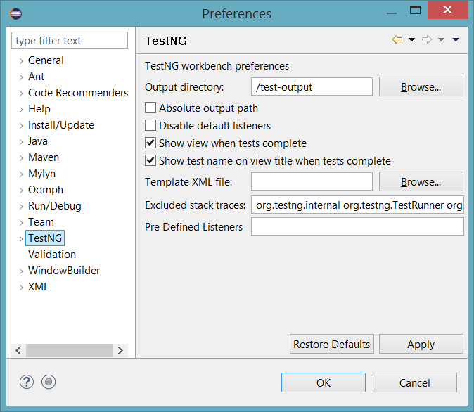
Install TestNG Contd..
After the restart, Go to Window > Preferences to see TestNG is included on the Preferences list

Slide 6
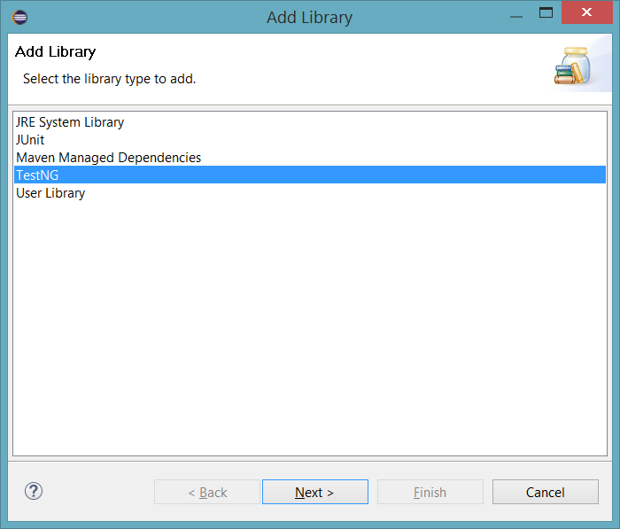
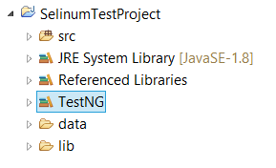
TestNG Library
Go to Buildpath of your project and Add TestNG library

Slide 7
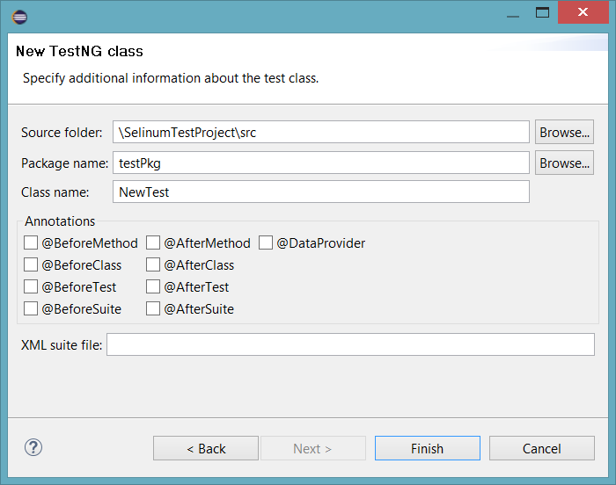
TestNG Program
New → Other → TestNG Class

Slide 8
TestNG Program structure
public class TestNGExample {
@Test
public void <test method>() {
//copy paste here - any selenium java program that we ran so far
}

Slide 9
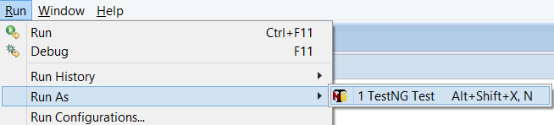
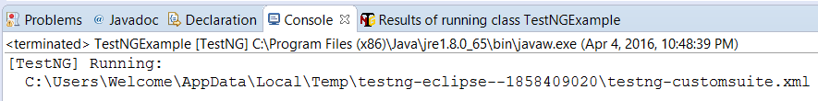
Run TestNG Test
Run → Run As → TestNGTest
Default xml will drive the test

Slide 10
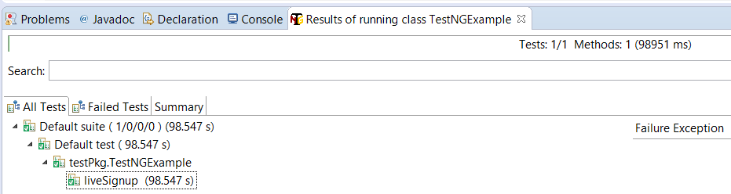
View Results

Slide 11
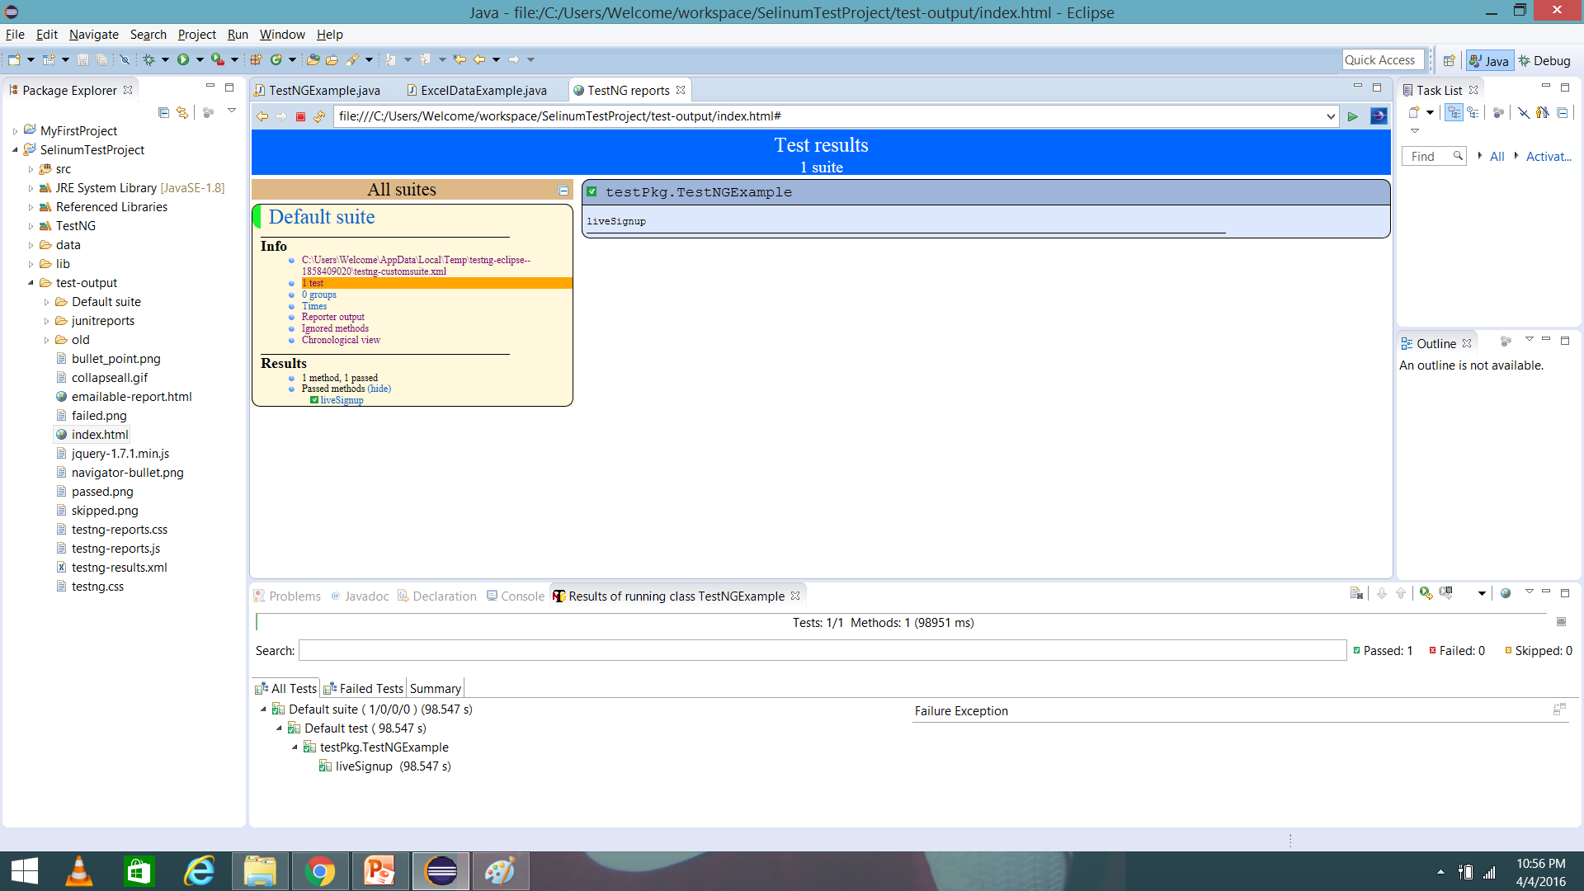
View HTML Report

Slide 12
Takeaway or Exercise
Create and run TestNG classes for all the webdriver java programs developed so far

Slide 13
Q & A

Slide 14
Thank You ☺

